Slide 1

ENGINEERING CHEMISTRY
Lata Pasupulety
Department of Science and Humanities

Slide 2

ENGINEERING CHEMISTRY
Module 4- Electrochemical equilibria
Module content:
Electrode potential and cell potential
Nernst Equation
Types of electrodes
Reference electrodes
Concentration cells
Ion-selective electrodes

Slide 3
ENGINEERING CHEMISTRY
Module 4- Electrochemical equilibria
Class content:
Origin of electrode potential
Cell potential
Nernst Equation

Slide 4
ENGINEERING CHEMISTRY
Module 4- Electrochemical equilibria
Electrochemistry
Deals with the inter conversion of chemical energy and electrical
energy
CHEMICAL ENERGY
ELECTRICAL ENERGY
Two types of cells:
Galvanic cell
Converts chemical energy to electrical energy
Batteries and fuel cells
Electrolytic
cell
Converts electrical energy to chemical energy
Cells used in electroplating

Slide 5
ENGINEERING CHEMISTRY
Module 4- Electrochemical equilibria
Electrochemical studies:
Redox reaction
Electrodes- Anode (oxidation)
Cathode (reduction)
Electrolytic conductance through electrolyte due to movement of ions
Acid, alkali or salt solutions
Molten electrolytes
Solid electrolytes
Electrode potential
When a metal rod is dipped in a solution of its own ions, the
electrical potential developed at the interface of the metal
and its solution
It is denoted by E

Slide 6
ENGINEERING CHEMISTRY
Module 4- Electrochemical equilibria
Origin of Electrode potential
When a metal M is in contact with solution containing its ions M^{n+}, two reactions are possible:
1. Ionisation (Oxidation)
M ⇌ M^{n+} + ne⁻
2. Deposition (Reduction)
M^{n+} + ne⁻ ⇌ M

Slide 7
ENGINEERING CHEMISTRY
Module 4- Electrochemical equilibria
Case I : If ionization is faster than deposition
the metal acquires net negative charge, consequently retards the rate of ionization and increases the rate of deposition. This ultimately lead to the establishment of equilibrium
the metal electrode gets negatively charged and attracts the layer of positive ions at the interface
an electrical double layer is formed at the interface of metal and solution known as Helmholtz electrical double layer
M ⇌ M^{n+} + ne⁻

Slide 8
ENGINEERING CHEMISTRY
Module 4- Electrochemical equilibria
Case II : deposition is faster than ionization
the metal acquires net positive charge, consequently retards the rate of deposition and increases rate of ionization. This ultimately lead to the establishment of equilibrium.
The metal electrode gets positively charged and attracts the layer of negative ions at the interface,
an electrical double layer is formed at the interface of metal and solution known as Helmholtz electrical double layer
M^{n+} + ne⁻ ⇌ M

Slide 9
ENGINEERING CHEMISTRY
Module 4- Electrochemical equilibria
Standard electrode potential
The potential developed at the interface of metal and solution, when the metal is in contact with a solution of its own ions having unit concentration at 298 K
In case of gas electrodes the partial pressure of gas is maintained at 1 atmospheric pressure.
It is represented as Eº
Electrochemical Cell
Single electrode potentials cannot be measured hence two electrodes are coupled together to form a cell
Cell notation
e.g. Daniel cell:
Zn(s)/Zn²⁺ (1M)//Cu²⁺ (1M) / Cu(s)

Slide 10
ENGINEERING CHEMISTRY
Module 4- Electrochemical equilibria
Cell potential
The difference in electrode potentials of the electrodes constituting the cell
It is denoted by E_{cell}
Standard cell potential
E_{cell} depends on concentration of the ions in the cell, temperature and the partial pressures of any gases involved in the cell reaction.
When all the concentrations are 1M, all partial pressures of gases are 1atm and temperature is 298K, the emf is called Standard cell potential, Eº_{cell}
Calculation of E_{cell}
E_{cell} = E_{rhs} – E_{lhs} = E_{cathode} – E _{anode}
E_{cell} represents the driving force for the cell reaction to take place
∆ G = - nFE_{CELL}
If reaction is spontaneous ∆ G is negative, thus E_{CELL} should be positive
If reaction is non spontaneous ∆ G is positive, thus E_{CELL} should be negative

Slide 11
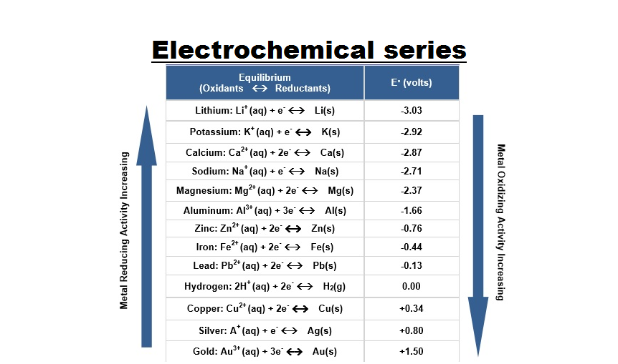
ENGINEERING CHEMISTRY
Module 4- Electrochemical equilibria
Electrochemical Series:
In order to predict the electrochemical behavior of an electrode – electrolyte system, elements are arranged in the order of their standard reduction potentials.
This arrangement is known as electrochemical series.
A negative value indicates oxidation tendency while a positive value indicates a reduction tendency.
Source:https://www.syedgilanis.com/2019/04/electrochemicalseries.html

Slide 12
ENGINEERING CHEMISTRY
Module 4- Electrochemical equilibria
Nernst equation for a single electrode
A quantitative relationship between electrode potential and concentration of species with which the electrode is reversible
The reaction at the electrode is
M^{n+} + ne⁻ ⇌ M
The maximum work that can be obtained is
-∆G = W_{max}
For an electrochemical system, maximum work done is
W_{max} = Total charge available × Energy available per unit charge
Total charge available , i.e., No. of moles of electrons exchanged in redox reaction (n) multiplied by charge carried per mole of electrons ,F(96,500 C/mol) = nF
Energy available per unit charge, i.e., electrode potential because
electrode potential = energy/unit charge = E
Therefore , W_{max} = nFE ; ∆ G = - nFE
Under standard conditions, ∆ Gº = - nFEº

Slide 13


ENGINEERING CHEMISTRY
Module 4- Electrochemical equilibria
M^{n+} + ne⁻ ⇌ M
A thermodynamic equation which relates reaction quotient and decrease in free energy is given by,
∆ G = ∆Gº + RTlnQ , where Q is the reaction quotient
The reaction quotient for the reaction is, Q= [M]/[M^{n+}]
Substituting for ∆ G, ∆Gº and Q , we get
Where , Eº = Standard electrode potential, n = number of electrons exchanged in the
redox reaction, R = Gas constant. 8.314 JK⁻¹ mol⁻¹ , T = temp in Kelvin,
F = Faraday 96500 C mol⁻¹
dividing throughout by –nF,

Slide 14




ENGINEERING CHEMISTRY
Module 4- Electrochemical equilibria
since [M] = 1 for pure substances,
at 298K,
Nernst equation may also be used to calculate. emf of electrochemical cells. For the cell reaction
aA + bB ⇌ cC + dD
Q = $\frac{{[C]}^{c}{[D]}^{d}}{{[A]}^{a}{[B}^{]b}}$
Nernst equation is
n= no. of e ⁻s transferred, Eº_{cell} = std. emf of the cell

Slide 15
THANK YOU
Lata Pasupulety
Department of Science and Humanities
latapasupulety@pes.edu
+91 80 6666 3333 Extn 759

